Slide 1
Image Enhancement-I
Lecture-3 (24th August 2021)

Slide 2
Topics covered till now:
Image Acquisition Process
Image sampling and quantization
Basic relationship between pixels
Neighbors
Connectivity
Path
Region & Adjacency
Boundary
Distance Measure

Slide 3
Image Sampling and Quantization
Image $f\left(x,y\right)$ has two components: co-ordinates and amplitude.
Image at lens focal plane is continuous.
To digitize an image, both co-ordinates and amplitude needs to be digitized.
Digitizing the co-ordinate values →sampling
Digitizing the amplitude values → quantization

Slide 4
How many quantization levels can we have?
Quantization levels→ [0, L-1]
L=2^{k}
k →no. of bits per channel

Slide 5
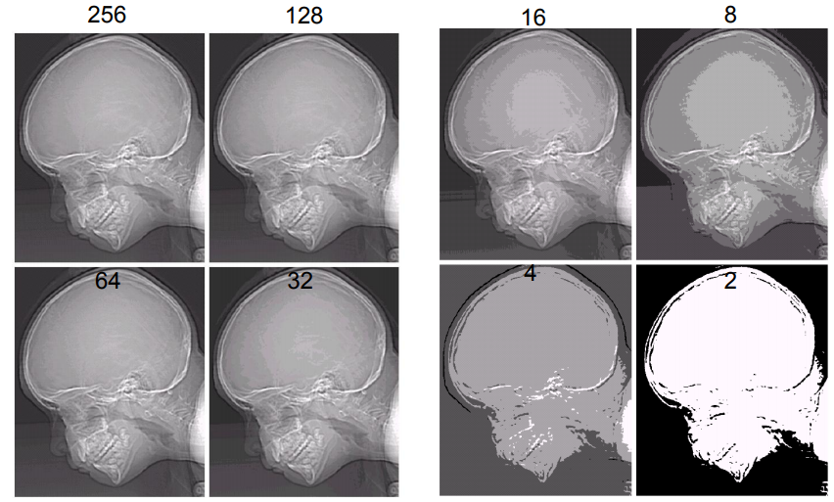
Images with varying intensity levels ‘L’

Slide 6
The number ‘b’ of bits required to store a M × N digitized image
b = M × N × k
k representing k bit image

Slide 7
Neighborhood
Neighbors of a pixel p at coordinates (x,y)
4-neighbors of p, denoted by N₄(p):
(x-1, y), (x+1, y), (x,y-1), and (x, y+1).
4 diagonal neighbors of p, denoted by N_{D}(p):
(x-1, y-1), (x+1, y+1), (x+1,y-1), and (x-1, y+1).
8 neighbors of p, denoted N₈(p)
N₈(p) = N₄(p) U N_{D}(p)

Slide 8
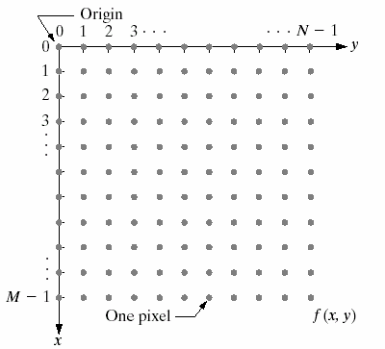
$$(x,y)$$

Slide 9
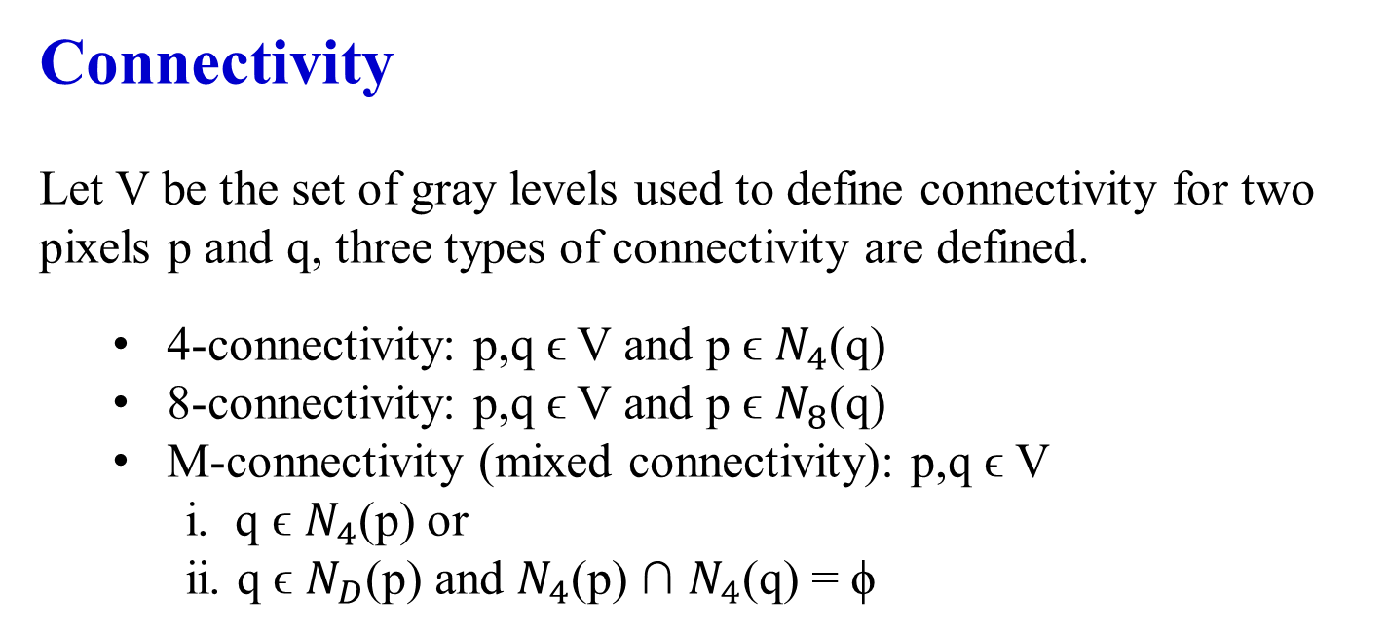
Connectivity
Let V be the set of gray levels used to define connectivity for two pixels p and q, three types of connectivity are defined.
4-connectivity: p,q ϵ V and p ϵ $N_{4}$(q)
8-connectivity: p,q ϵ V and p ϵ $N_{8}$(q)
M-connectivity (mixed connectivity): p,q ϵ V
i. q ϵ $N_{4}$(p) or
ii. q ϵ $N_{D}$(p) and $N_{4}$(p) ∩ $N_{4}$(q) = ϕ
Eg. V={1}
0 | 1 | 1
0 | 1 | 0
0 | 0 | 1
0 | 1 | 1
0 | 1 | 0
0 | 0 | 1
0 | 1 | 1
0 | 1 | 0
0 | 0 | 1
q
p
4-connectivity
8-connectivity
M-connectivity

Slide 10
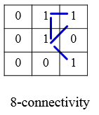
Path
A (digital) path (or curve) from pixel p with coordinates (x₀, y₀) to pixel q with coordinates (x_{n}, y_{n}) is a sequence of distinct pixels with coordinates
(x₀, y₀), (x₁, y₁), …, (x_{n}, y_{n})
where (x_{i}, y_{i}) and (x_{i-1}, y_{i-1}) are adjacent for 1 ≤ i ≤ n.
Here n is the length of the path.
If (x₀, y₀) = (x_{n}, y_{n}), the path is closed path.
We can define 4-, 8-, and m-paths based on the type of adjacency used.
p
q

Slide 11
Region & Adjacency
We call ‘R’ a region of the image if R is a connected set.
Two regions, $R_{i}$ and $R_{j}$ are said to be adjacent if their union forms a connected set.
Regions that are not to be adjacent are said to be disjoint.
1 | 1 | 1
1 | 0 | 1
0 | 1 | 0
0 | 0 | 1
1 | 1 | 1
1 | 1 | 1
Region 1
8-adjacency
4-adjacency
8-adjacency
m-adjacency
Region 2

Slide 12
Boundary
The boundary of the region R is the set of pixels in the region that have one or more neighbors that are not in R (background).
0 | 1 | 0 | 0 | 0
1 | 1 | 1 | 0 | 0
0 | 1 | 1 | 1 | 0
0 | 1 | 1 | 1 | 1
1 | 1 | 1 | 1 | 0
0 | 1 | 0 | 0 | 0
Black- background
White- foreground
8 - connectivity

Slide 13
0 | 1 | 0 | 0 | 0
1 | 1 | 1 | 0 | 0
0 | 1 | 1 | 1 | 0
0 | 1 | 1 | 1 | 1
1 | 1 | 1 | 1 | 0
0 | 1 | 0 | 0 | 0
Black- background
White- foreground
8 - connectivity
4 - connectivity
MATLAB: B = bwboundaries (binary_image,connectivity)

Slide 14
Euclidean Distance
The Euclidean Distance between p and q is defined as:
D_{e} (p,q) = [(x – s)² + (y - t)²]^{1/2}
D_{e} (p,q)
q (s,t)
p (x,y)

Slide 15
City-Block Distance
The D₄ distance (also called city-block distance) between p and q is defined as:
D₄ (p,q) = | x – s | + | y – t |
q (s,t)
D₄
p (x,y)

Slide 16
Chessboard Distance
The D₈ distance (also called chessboard distance) between p and q is defined as:
D₈ (p,q) = max(| x – s |,| y – t |)
q (s,t)
D_{8(b)}
p (x,y)
D_{8(a)}
D₈ = max(D_{8(a) ,} D_{8(b)})

Slide 17
Today’s lecture
Image enhancement techniques
Intensity transformation function
Image negative
Log transformation
Gamma transformation
Piecewise linear transformation
Contrast stretching
Intensity level slicing
Histogram processing

Slide 18
Image enhancement techniques
Objective – process an image so that the result is more suitable than the original image for a specific application. (improve the quality)
Methods:
Spatial Domain direct manipulation of pixels of the image
Frequency Domain modifying the frequency transformed image

Slide 19
Spatial Domain
These techniques operate directly on the pixels.
More efficient computation and requires less processing resources to implement
Spatial Domain Process is defined by g(x,y)=T[f(x,y)]
T is an operator on input image defined over a neighborhood of point (x,y)
OUTPUT IMAGE
INPUT IMAGE

Slide 20
1. Image Negative
Let the image has an intensity level in the range [0 L-1], then the intensity transformation is given by s=L-1-r
s=T(r)
L-1
L=intensity levels
Output intensity
0
L-1
r
Input intensity

Slide 21
2. Log Transformation
For an image having intensity ranging from [0 L-1], log transformation is given by s=c log(1+r) , where c is a constant.
s=T(r)
Maps the narrow range of low intensity values of input levels to wider range of output levels.
Higher range of high intensity input levels is mapped to narrow range of output levels.
L-1
Output intensity
0
L-1
r
Input intensity

Slide 22
3. Power-law (Gamma) Transformation
This has the basic form s=c r^{γ} ,where c and γ are positive constants
Dark input → bright output when gamma<1
Same input and output at gamma=1
bright input → dark output when gamma >1
Plot for c=1

Slide 23
Gamma correction is very important when to reproduce an image exactly on a display system.
MRI of fractured human spine
Result of a transformation for γ=0.3

Slide 24
MRI of fractured human spine
Result of a transformation for γ=0.6
Result of a transformation for γ=0.4
Result of a transformation for γ=0.3

Slide 25
Result of a transformation for c=1 and γ=3
Arial image

Slide 26
Result of a transformation for c=1 and γ=4
Result of a transformation for c=1 and γ=5

Slide 27
4. Contrast stretching
s = T(r)
L-1
Sometimes, image viewed in the screen is very dark (poor contrast).
Poor illumination
dynamic range of the sensor is very small. (capacity to record min and max intensity value)
aperture of lens is not properly set.
light
output intensity level, s
dark
0
0
L-1
dark
light
Expand a range of intensities at input to desired range at output.
Input intensity level, r

Slide 28
Contrast stretching
L-1
Controls the shape of the transformation function
(r₂,s₂)
3L/4
L/2
T(r)
output intensity level, s
L/4
0
(r₁,s₁)
0
L/4
L/2
3L/4
L-1
Input intensity level, r

Slide 29
Contrast stretching
Suppose r₁=s₁ and r₂=s₂
L-1
L-1
(r₂,s₂)
(r₂,= s₂)
3L/4
3L/4
L/2
T(r)
L/2
T(r)
output intensity level, s
output intensity level, s
L/4
L/4
(r₁,s₁)
(r₁,=s₁)
0
0
0
L/4
L/2
3L/4
L-1
0
L/4
L/2
3L/4
L-1
Input intensity level, r
Input intensity level, r

Slide 30
Contrast stretching
Suppose r₁=r₂ and s₁=0 and s₂=L-1
L-1
(r₂)
L-1
(r₂,s₂)
3L/4
3L/4
L/2
T(r)
L/2
T(r)
output intensity level, s
output intensity level, s
L/4
L/4
(r₁,s₁)
0
0
(r₁)
0
L/4
L/2
3L/4
L-1
0
L/4
L/2
3L/4
L-1
Input intensity level, r
Input intensity level, r

Slide 31
Contrast stretching (Example)

Slide 33
Contrast stretching (Example)

Slide 34
5. Intensity Level slicing
Highlighting specific range of intensities.
Example :
Enhancing features such as masses of water in the satellite imagery
Enhancing flaws in X-ray images.
Contrast stretching: whole image intensity is affected

Slide 35
L-1
L-1
T(r)
s
r
0
L-1

Slide 36
L-1
T(r)
s
r
0
L-1

Slide 37
Intensity Level slicing (Example)

Slide 38
6. Histogram Processing
What is histogram
Histogram based techniques
Histogram equalization
Histogram specification/matching/modification

Slide 39

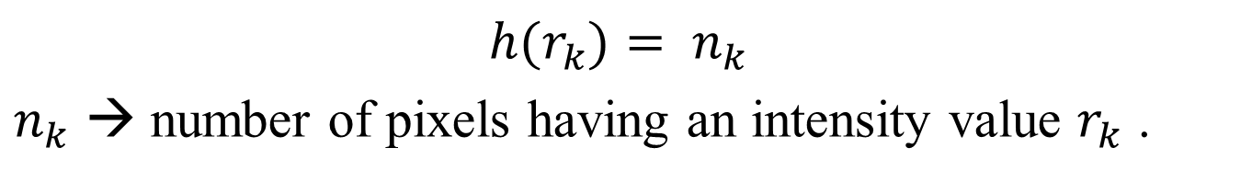
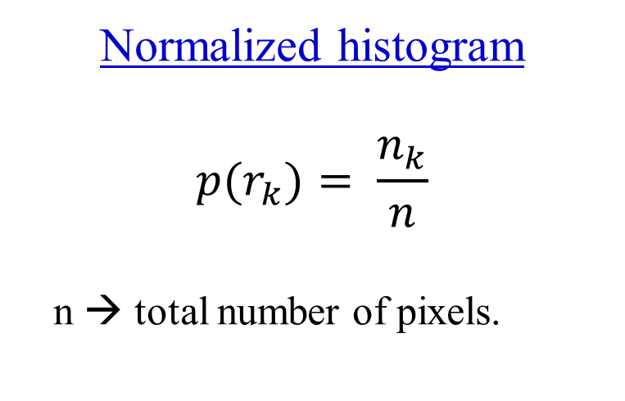
What is a histogram?
→Gives a global description of an appearance of an image.
${h(r}_{k})= n_{k}$
$n_{k}$ → number of pixels having an intensity value $r_{k}$ .
$$n_{k}$$
Normalized histogram
$${p(r}_{k})= \frac{n_{k}}{n}$$
n → total number of pixels.
Intensity values

Slide 40
Dark image
Darker region

Slide 41
Bright image
Lighter region

Slide 42
Low contrast image
Neither dark nor bright

Slide 43
High contrast image
Detailed image

Slide 44
Histogram gives global appearance not the content of image.
Histogram based techniques modifies the histogram of image to appear in the way we want.
Histogram equalization
Histogram specification/matching/modification

Slide 45
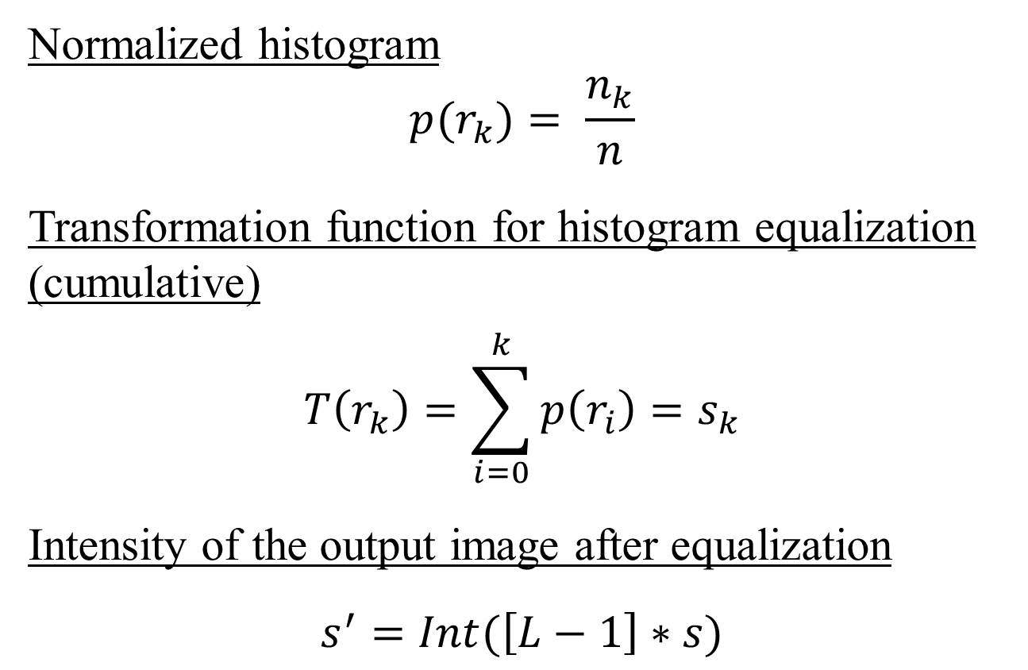
Histogram equalization
Normalized histogram
$${p(r}_{k})= \frac{n_{k}}{n}$$
Transformation function for histogram equalization
(cumulative)
$$T\left(r_{k}\right)=\sum_{i=0}^{k}{p\left(r_{i}\right)}=s_{k}$$
Intensity of the output image after equalization
$$s^{′}=Int(\left[L−1\right]∗s)$$

Slide 46
R (input intensity values) | No. of pixels | P(r) (normalized histogram) | T(r) CDF | s’ (output intensity values)
0 | 2 | 0.05 | 0.05 | 0
1 | 2 | 0.05 | 0.1 | 0
2 | 0 | 0 | 0.1 | 0
3 | 0 | 0 | 0.1 | 0
4 | 0 | 0 | 0.1 | 0
5 | 6 | 0.15 | 0.25 | 1
6 | 14 | 0.35 | 0.60 | 4
7 | 16 | 0.40 | 1 | 7
 | Sum=40

Slide 47
R (input intensity values) | No. of pixels | P(r) (normalized histogram) | T(r) CDF | s’ (output intensity values)
0 | 2 | 0.05 | 0.05 | 0
1 | 2 | 0.05 | 0.1 | 0
2 | 0 | 0 | 0.1 | 0
3 | 0 | 0 | 0.1 | 0
4 | 0 | 0 | 0.1 | 0
5 | 6 | 0.15 | 0.25 | 1
6 | 14 | 0.35 | 0.60 | 4
7 | 16 | 0.40 | 1 | 7
 | Sum=40

Slide 49

Histogram matching
Input histogram
$${p_{r}(r}_{k})= \frac{n_{k}}{n}$$
Target histogram ${p_{z}(z}_{k})$
$$T\left(r_{k}\right)=\sum_{i=0}^{k}{p_{r}\left(r_{i}\right)}=s_{k}$$
$$v_{k}=G\left(z_{k}\right)=\sum_{i=0}^{k}{p_{z}\left(z_{i}\right)}=s_{k}$$
Transformation matrices
$$z_{k}=\min{value of z for which G\left(z\right)−s≥0}$$

Slide 50
R (input intensity values) | Pr(r) (histogram) | T(r) = s | Pz(z) | G(z) | Z’ (output intensity)
0
1
2
3
4
5
6
7

Slide 51
R (input intensity values) | Pr(r) (histogram) | T(r) = s | Z | Pz(z) | G(z) | Z’ (output intensity)
0 | 0 | 0 | 0 | 0 | 0 | 0
1 | 0.1 | 0.1 | 1 | 0.1 | 0.1 | 1
2 | 0.1 | 0.2 | 2 | 0.2 | 0.3 | 2
3 | 0.3 | 0.5 | 3 | 0.4 | 0.7
4 | 0 | 0.5 | 4 | 0.2 | 0.9
5 | 0 | 0.5 | 5 | 0.1 | 1
6 | 0.4 | 0.9 | 6 | 0 | 1
7 | 0.1 | 1 | 7 | 0 | 1

Slide 52
R (input intensity values) | Pr(r) (histogram) | T(r) = s | Z | Pz(z) | G(z) | Z’ (output intensity)
0 | 0 | 0 | 0 | 0 | 0 | 0
1 | 0.1 | 0.1 | 1 | 0.1 | 0.1 | 1
2 | 0.1 | 0.2 | 2 | 0.2 | 0.3 | 2
3 | 0.3 | 0.5 | 3 | 0.4 | 0.7 | 3
4 | 0 | 0.5 | 4 | 0.2 | 0.9 | 3
5 | 0 | 0.5 | 5 | 0.1 | 1 | 3
6 | 0.4 | 0.9 | 6 | 0 | 1 | 4
7 | 0.1 | 1 | 7 | 0 | 1 | 5

Slide 53
